Slide 1

Basics of Neural Network Programming
Vectorizing Logistic
Regression
deeplearning.ai
Notes:
1

Slide 2
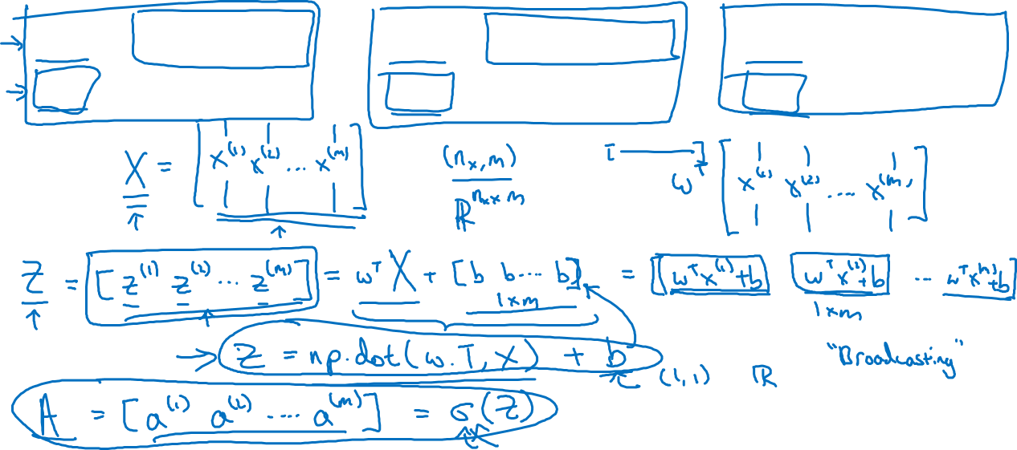






Vectorizing Logistic Regression

Slide 3
Basics of Neural Network Programming
Vectorizing Logistic
Regression’s Gradient
Computation
deeplearning.ai
Notes:
<number>

Slide 4
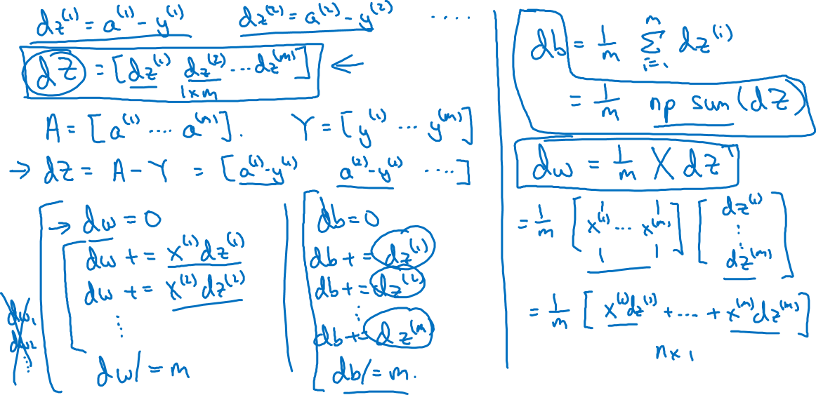
Vectorizing Logistic Regression

Slide 5
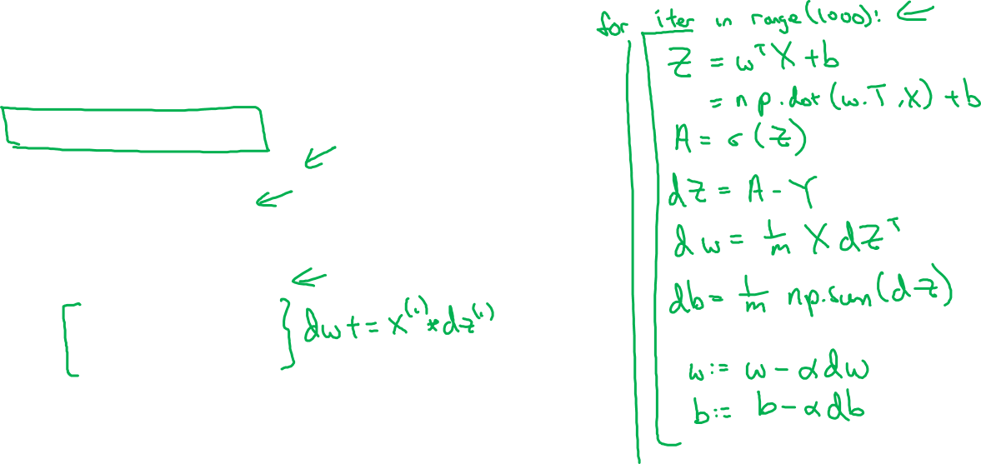









Implementing Logistic Regression
for i = 1 to m:
=
=

